Slide 1
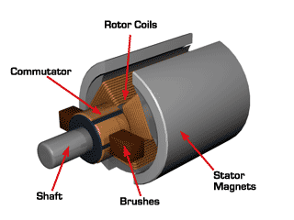
DC Motors
Permanent magnet DC Motors
A permanent magnet dc motor (PMDC) is a dc motor whose poles are made of permanent magnets. A PMDC motor is basically the same machine as a shunt dc motor, except that the flux of a PMDC motor is fixed.
Advantage: They do not have the field circuit copper losses and they can be smaller than corresponding shunt dc motors.
Disadvantages: It is not possible to control the speed of the PMDC motor by varying the field current or flux. Furthermore, permanent magnets motors run the risk of demagnetization in overload conditions.

Slide 2
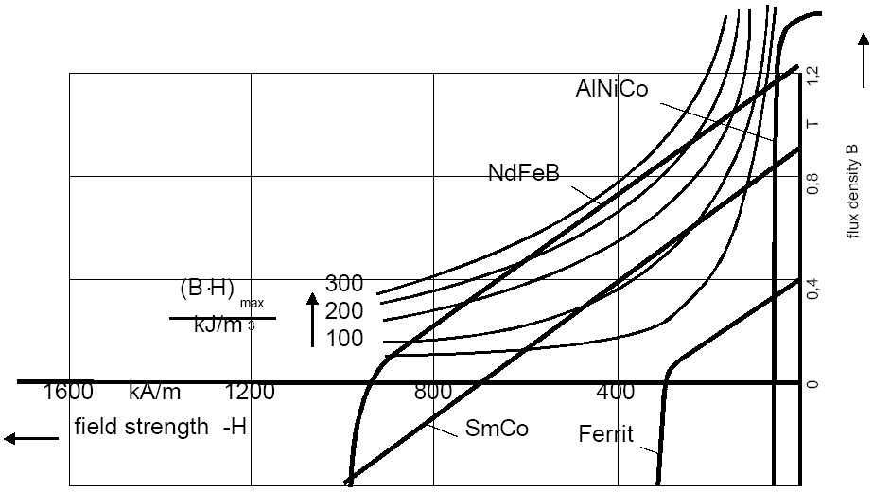
DC Motors
Permanent magnet DC Motors

Slide 3
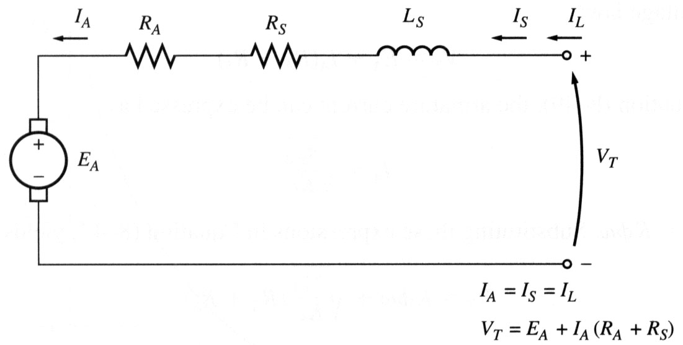

DC Motors
Series DC Motors
A series DC motor is a dc motor whose field windings consist of relatively few turns connected in series with the armature circuit. The basic behaviour of a series dc motor is due to the fact that the flux is directly proportional to the armature current, at least until saturation is reached. As the load on the motor increases, its flux increases too. As seen earlier, an increase in flux in the motor causes a decrease in its speed. The result is that a series dc motor has a sharply drooping torque-speed characteristic.

Slide 4
DC Motors
Series DC Motors
The flux is directly proportional to the armature current. As the load on the motor increases, its flux increases too, causing a decrease in its speed. The result is that a series dc motor has a sharply drooping torque-speed characteristic.
The flux in the machine can be given by φ = cI_{A} where c is a constant of proportionality. Thus,
τ_{ind} = K φ I_{A} = KcI_{A}²
Series dc motors are therefore used in applications requiring very high starting torques. Example: starter motors in cars, elevator motors, tractor motors etc.

Slide 5
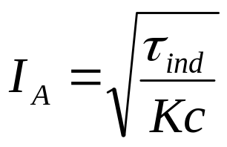

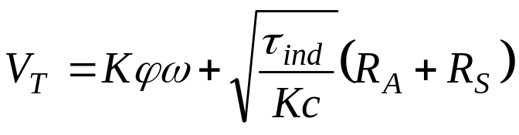
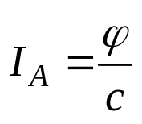
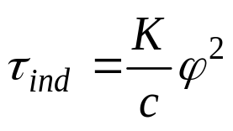
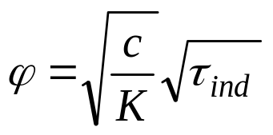

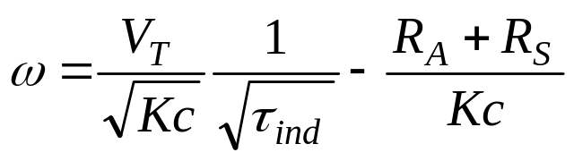
DC Motors
Series DC Motors
The Output Characteristic of a Series DC Motor
τ_{ind} =KcI_{A}²

Slide 6
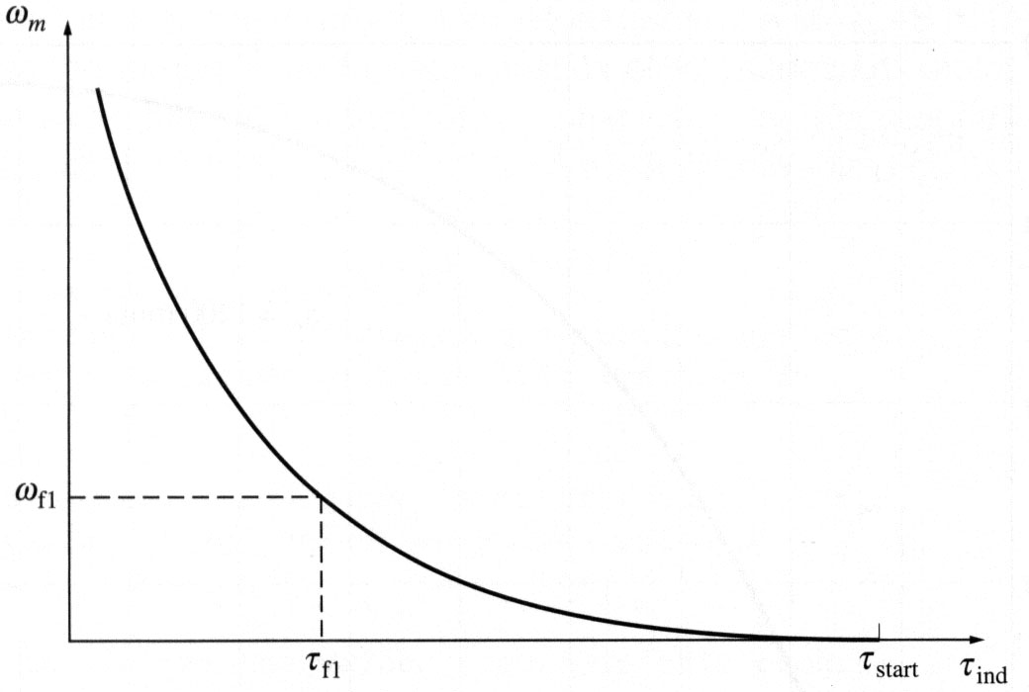
DC Motors
Series DC Motors
The Output Characteristic of a Series DC Motor
Steps must be taken to ensure that a series motor always has a load! Therefore, it is not a good idea to connect such motors to loads by a belt or other mechanism that could break.

Slide 7
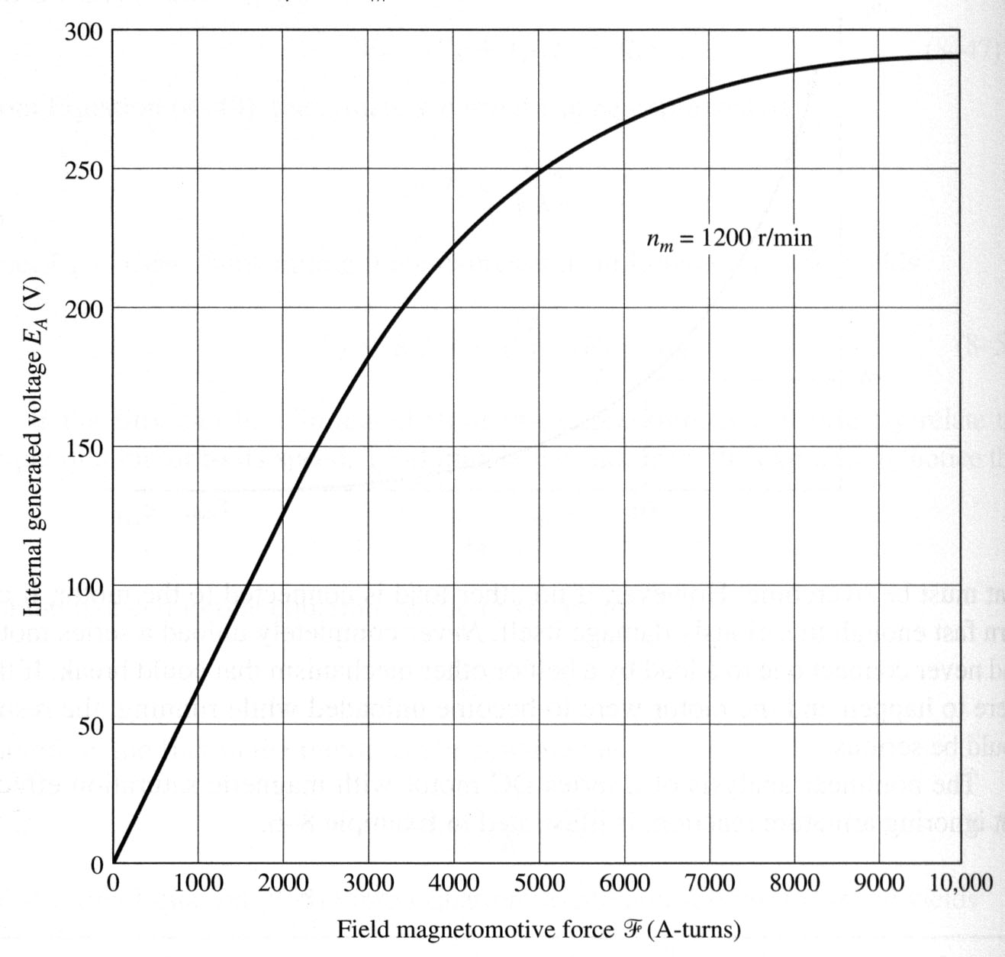
Series motor: terminal characteristic – Example
Example : A 250 V series DC motor with compensating windings has a total series resistance R_{A} + R_{S} of 0.08 Ω. The series field consists of 25 turns per pole and the magnetization curve is as below:
Find the speed and induced torque of this motor when its armature current is 50 A.
To analyze the behavior of a series motor with saturation, we pick points along the operating curve and find the torque and speed for each point. Since the magnetization curve is given in units of mmf (ampere-turns) vs. E_{A} for a speed of 1200 rpm, calculated values of E_{A} must be compared to equivalent values at 1200 rpm.

Slide 8
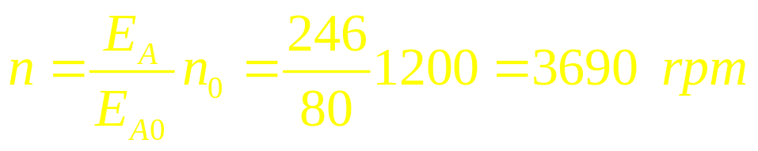
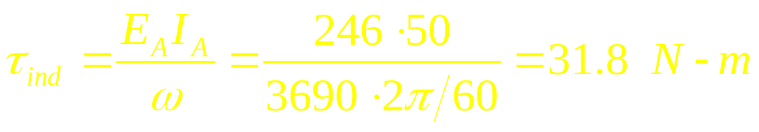
Series motor: terminal characteristic – Example
For I_{A} = 50 A
Since for a series motor I_{A} = I_{F} = 50 A, the mmf is
From the magnetization curve, at this mmf, the internal generated voltage is
E_{A0} = 80 V. Since the motor has compensating windings, the correct speed of the motor will be
The resulting torque:

Slide 9
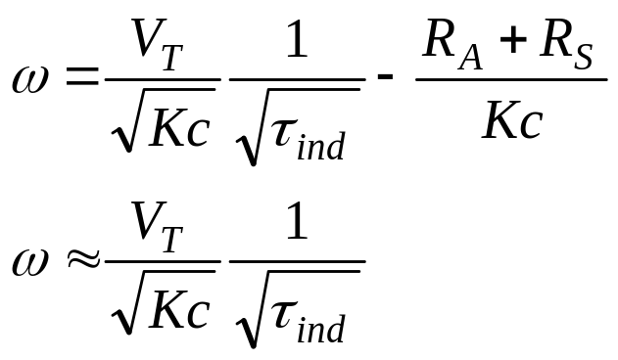
DC Motors
Series DC Motors
Speed Control of Series DC Motors
The most efficient way to change the speed of a series dc motor is to change the terminal voltage of the motor. If terminal voltage is increased, the speed will increase for any given torque.

Slide 10
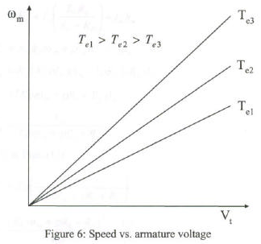
Speed Control in Series DC Motors
Armature Voltage Control:
A variable dc voltage can be obtained from a power electronic converter.

Slide 11
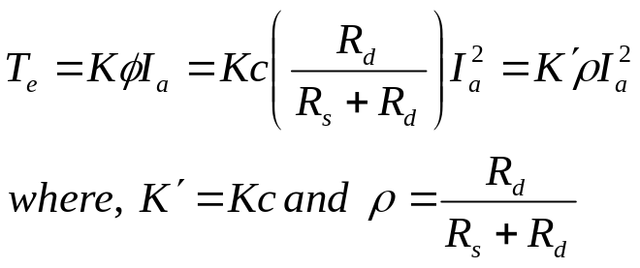
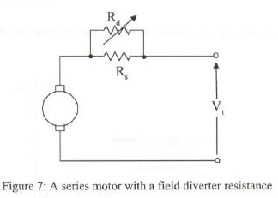
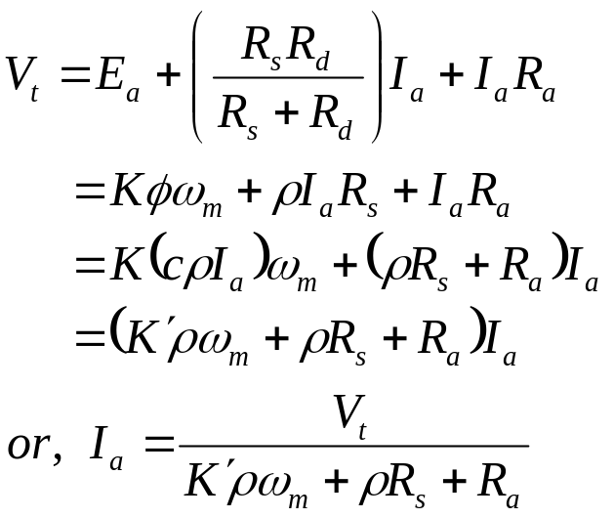
Speed Control in Series DC Motors
Field Control:
Control of field flux in a sries motor is achieved by using a diverter resistance.
The developed torque can be expressed as.
φ = cI_{a}

Slide 12
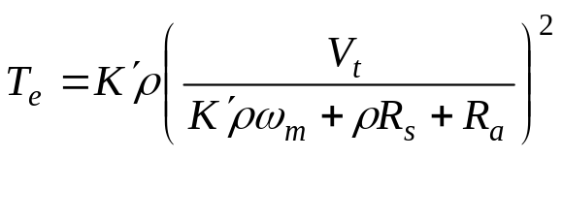
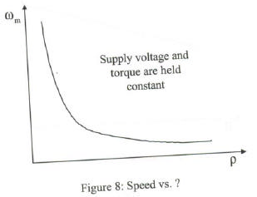
Speed Control in Series DC Motors

Slide 13
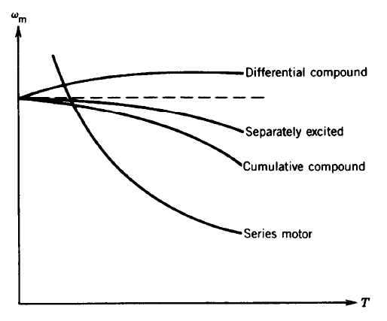
DC Motors
The Output Characteristic of Series DC Motors

Slide 14
DC motor starters
In order for DC motors to function properly, they must have some special control and protection equipment associated with them. The purposes of this equipment are:
To protect the motor against damage due to short circuits in the equipment;
To protect the motor against damage from long-term overloads;
To protect the motor against damage from excessive starting currents;
To provide a convenient manner in which to control the operating speed of the motor.

Slide 15
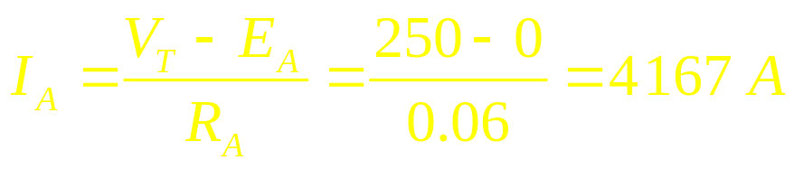
DC motor problems on starting
At starting conditions, the motor is not turning, therefore the internal generated voltage E_{A} = 0V. Since the internal resistance of a normal DC motor is very low (3-6 % pu), a very high current flows.
For instance, for a 50 hp, 250 V DC motor with armature resistance R_{A} of 0.06 Ω and a full-load current about 200 A, the starting current is
This current is over 20 times the motor’s rated full-load current and may severely damage the motor.
A solution to the problem of excessive starting current is to insert a starting resistor in series with the armature to limit the current until E_{A} can build up to limit the armature current. However, this resistor must be removed from the circuit as the motor speed is high since otherwise such resistor would cause losses and would decrease the motor’s torque-speed characteristic.

Slide 16
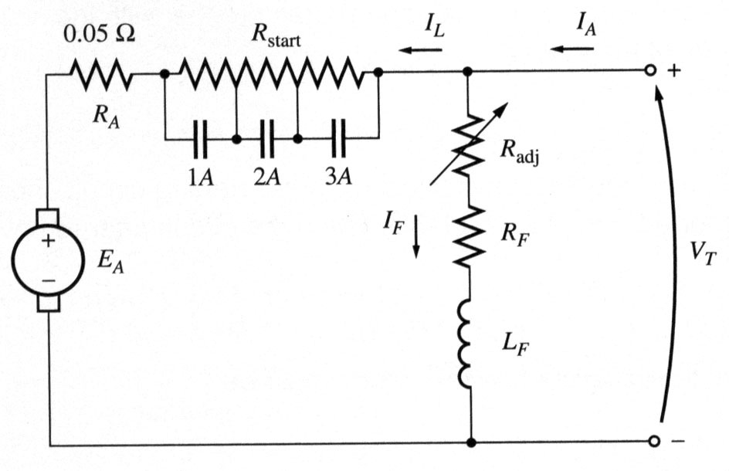
DC motor problems on starting
In practice, a starting resistor is made up of a series of resistors that can be successively removed from the circuit as the motor speeds up.
A shunt motor with an extra starting resistor that can be cut out of the circuit in segments by closing the 1A, 2A, and 3A contacts.
Therefore, two considerations are needed to be taken into account:
Select the values and the number of resistor segments needed to limit the starting current to desired
ranges; Design a control circuit shutting the resistor bypass contacts at the proper time to remove particular parts of the resistor from the circuit.

Slide 17
DC motor problems on starting: Ex
Example: A 100 hp, 250 V 350 A shunt DC motor with an armature resistance of 0.05 Ω needs a starter circuit that will limit the max starting current to twice its rated value and which will switch out sections of resistor once the armature current decreases to its rated value.
How many stages of starting resistance will be required to limit the current to the specified range?
What must the value of each segment of the resistor to be? At what voltage should each stage of the starting resistance be cut out?

Slide 18
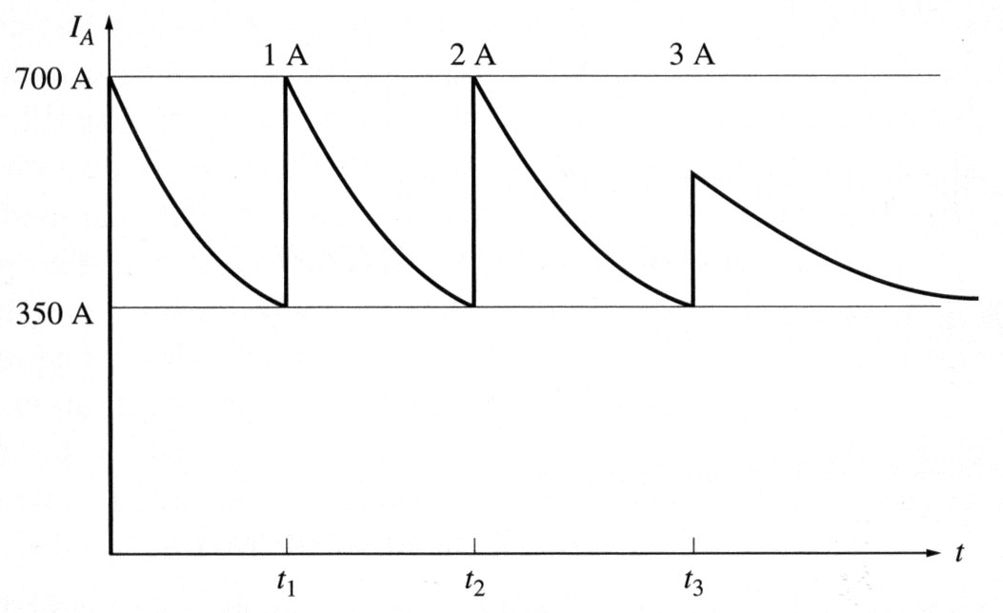
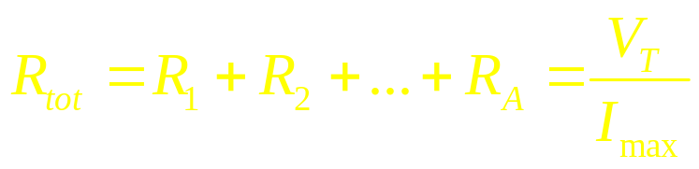

DC motor problems on starting: Ex
a. The starting resistor must be selected such that the current flow at the start equals twice the rated current. As the motor speeds up, an internal voltage E_{A} (which opposes the terminal voltage of the motor and, therefore, limits the current) is generated. When the current falls to the rated value, a section of the starting resistor needs to be taken out to increase the current twice. This process (of taking out sections of the starting resistor) repeats until the entire starting resistance is removed. At this point, the motor’s armature resistance will limit the current to safe values by itself.
The original resistance in the starting circuit is
After the stages 1 through i are shorted out, the total resistance left in the starting circuit is

Slide 19
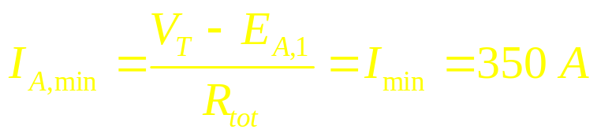
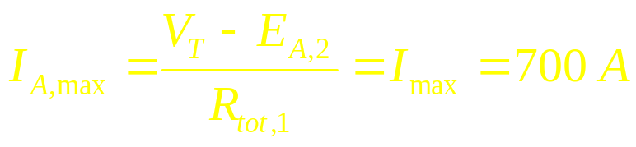

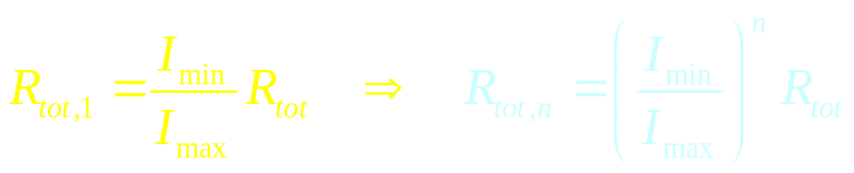
DC motor problems on starting: Example
The resistance R₁ must be switched out of the circuit when the armature current falls to
After the resistance R₁ is out of the circuit, the armature current must increase to
Since E_{A} = Kφω, the quantity V_{T} – E_{A} must be constant when the resistance is switched out. Therefore
The resistance left in the circuit is

Slide 20
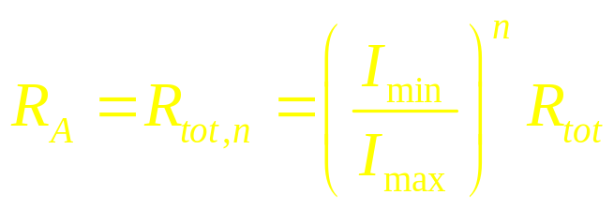
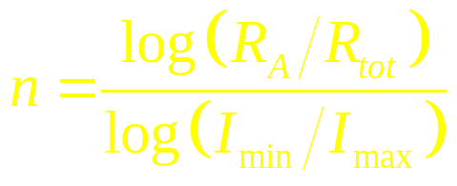
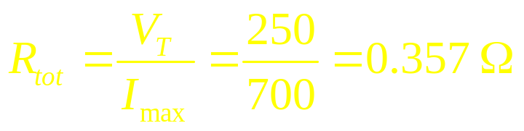
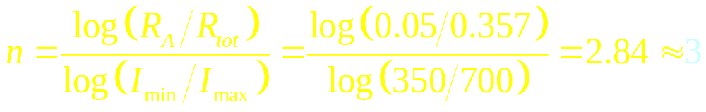
DC motor problems on starting: Ex
The starting process is completed when R_{tot,n} is not greater than the internal armature resistance R_{A}. At the boundary:
Solving for n:
Notice that the number of stages n must be rounded up to the next integer.

Slide 21
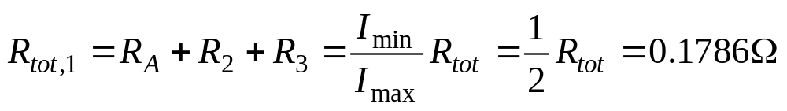
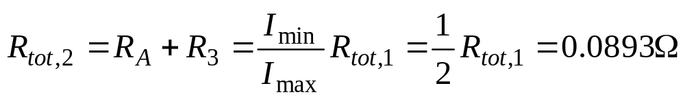
DC motor problems on starting: Ex
b. The armature circuit will contain the armature resistance R_{A} and three starting resistors. At first, E_{A} = 0, I_{A} = 700 A, and the total resistance is 0.357 Ω. The total resistance will be in the circuit until the current drops to 350 A. This occurs when
At this time, the starting resistor R₁ will be taken out making
This (new) total resistance will be in the circuit until the current drops again to 350 A. This occurs when
At this time, the starting resistor R₂ will be taken out leaving

Slide 22
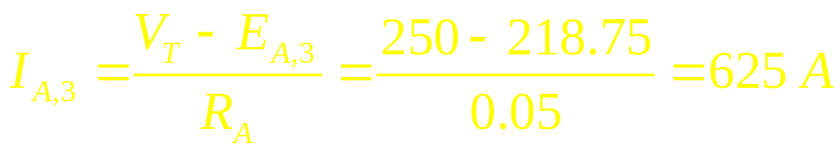
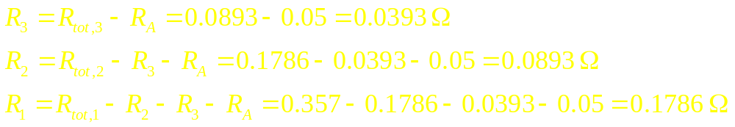
DC motor problems on starting: Ex
This total resistance will be in the circuit until the current drops again to 350 A. This occurs when
At this time, the starting resistor R₃ will be taken out leaving only R_{A} in the circuit. The motor’s current at that moment will increase to
which is less than the allowed value. Therefore, the resistances are
The resistors R₁, R₂, and R₃ are cut out when E_{A} reaches 125 V, 187.5 V, and 218.75 V, respectively.

Slide 23
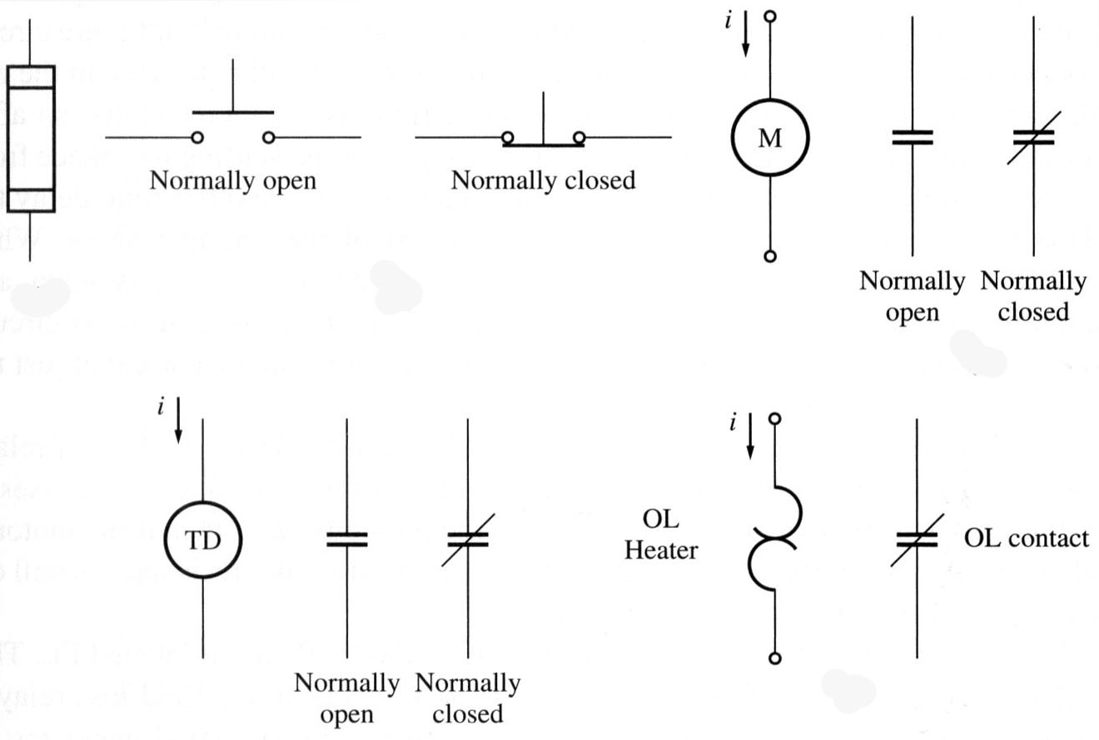
DC motor starting circuits
Several different schemes can be used to short contacts and cut out the sections of a starting resistor. Some devices commonly used in motor-control circuits are
Spring-type push button switches
Relay: a main coil and a number of contacts
Fuses: protects against short circuits
Time delay relay similar to ordinary relay except for having adjustable time delay.
Overload: a heater coil and normally closed contacts

Slide 24
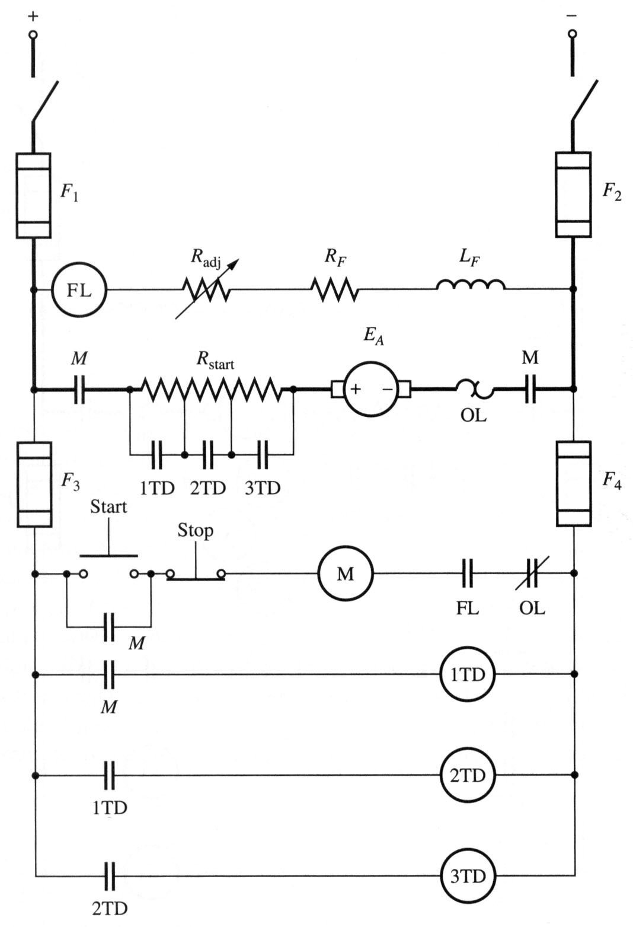
DC motor starting circuits
A common DC motor starting circuit:
A series of time delay relays shut contacts removing each section of the starting resistor at approximately correct times.
Notice that the relay 1TD is energized at the same time as the motor starts – contacts of 1TD will shut a part of the starting resistor after some time. At the same instance, relay 2TD is energized and so on…
Observe also 4 fuses protecting different parts of the circuit and the overload in series with the armature winding.

Slide 25
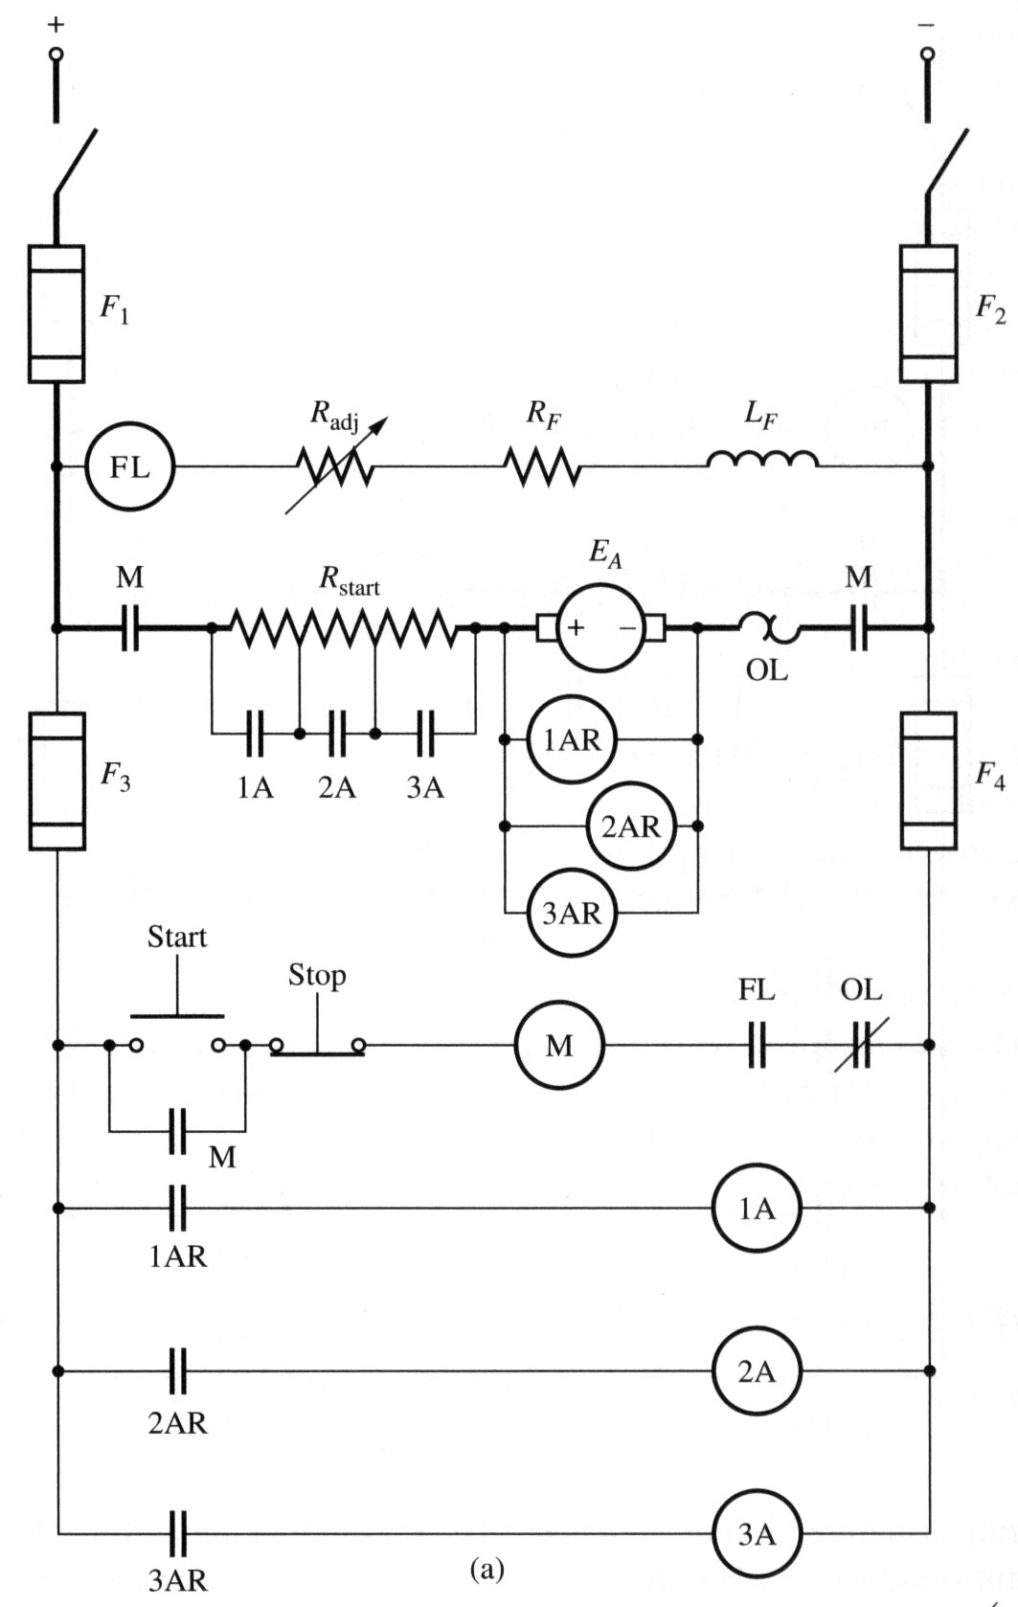
DC motor starting circuits
Another type of motor starter:
A series of relays sense the value of armature voltage E_{A} and cut out the starting resistors as it riches certain values.
This starter type is more robust to different loads.
FL is the field loss relay: if the field is lost for any reason, power to the M relay will be turned off.

Slide 26
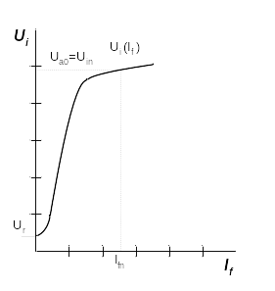
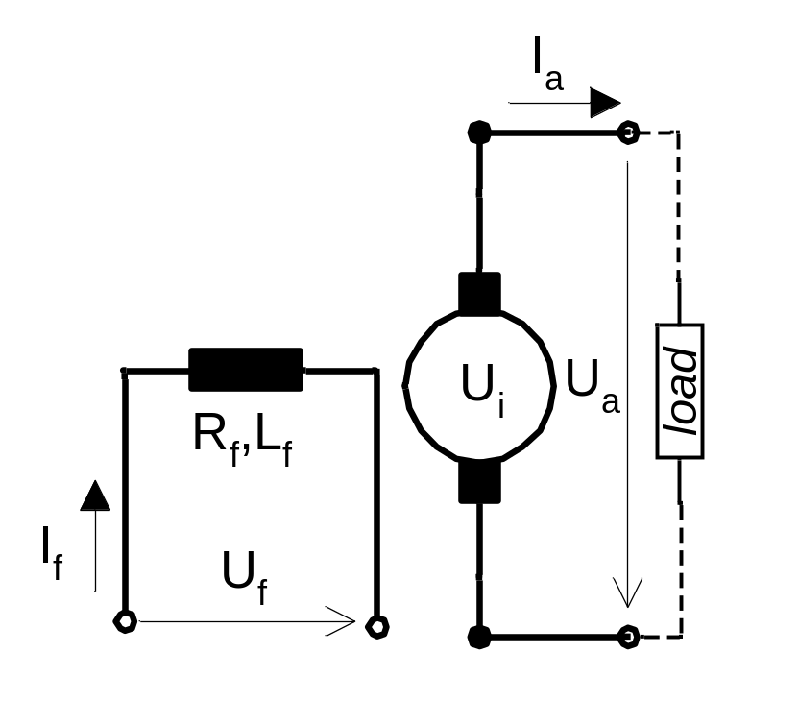
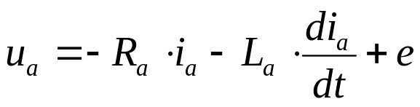
SEPARATELY EXCITED GENERATOR
©NOTES - Doc. Ing. Pavel Pivoňka, CSc.
Notes:
DC generators have largely been replaced by controlled semiconductor rectifiers. The understanding of generator characteristics is important for electrical braking of DC motors. For generator purposes only two types of DC machines are worthy to mention – separately excited and shunt generators

Slide 27
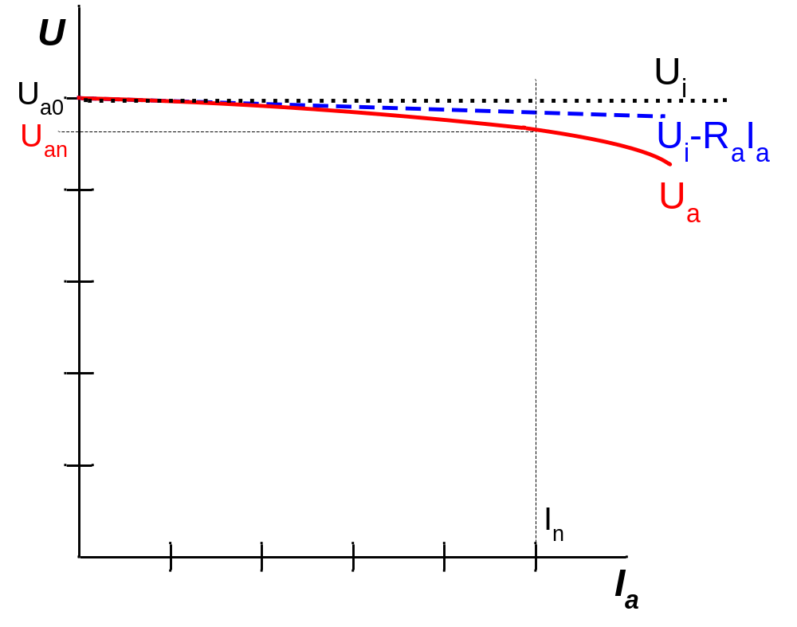
VOLT-AMPERE (LOAD) CHARACTERISTICS
Difference due to
ARMATURE
REACTION
©NOTES - Doc. Ing. Pavel Pivoňka, CSc.
Notes:
These generators are usually used in applications where reverse of output voltage polarity is not required, and the extra supply for the field winding is not available. This is, for example, the case of a DC source for vehicle lights, pilot exciters by synchronous machines etc. In fact each separately excited machine with an excitation winding can be connected as a shunt machine.
One advantage of a shunt generator is that it can work with short-circuited terminals as the current source (I_{sc}), because its short-circuit current I_{sc} is lower than the normal rated current I_{n}. Figure shows this fact in comparison of the load characteristics of the separately excited and shunt generator.

Slide 28
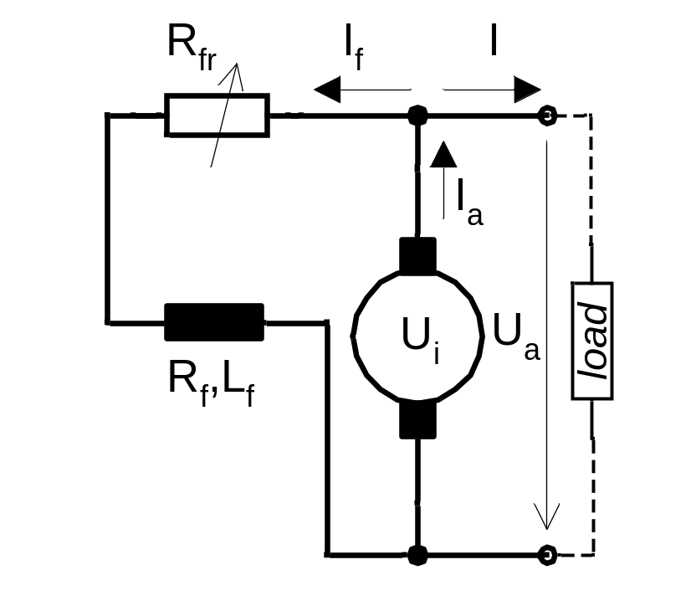

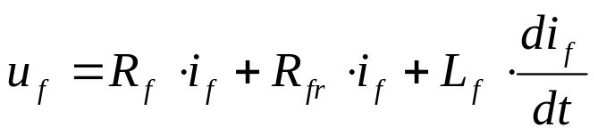
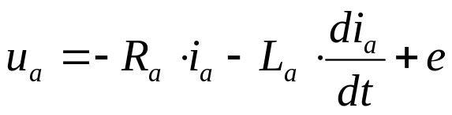

SHUNT GENERATOR
©NOTES - Doc. Ing. Pavel Pivoňka, CSc.
Notes:
DC generators have largely been replaced by controlled semiconductor rectifiers. The understanding of generator characteristics is important for electrical braking of DC motors. For generator purposes only two types of DC machines are worthy to mention – separately excited and shunt generators

Slide 29
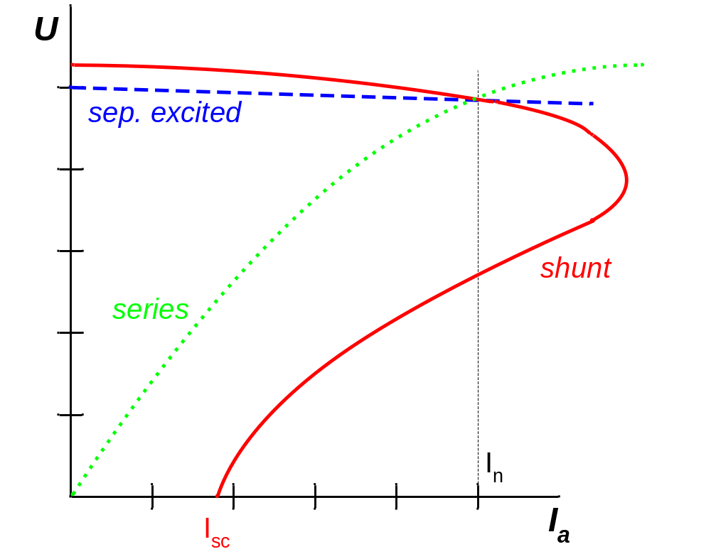
COMPARISON OF GENERATORS
SHUNT:
©NOTES - Doc. Ing. Pavel Pivoňka, CSc.
Notes:
These generators are usually used in applications where reverse of output voltage polarity is not required, and the extra supply for the field winding is not available. This is, for example, the case of a DC source for vehicle lights, pilot exciters by synchronous machines etc. In fact each separately excited machine with an excitation winding can be connected as a shunt machine.
One advantage of a shunt generator is that it can work with short-circuited terminals as the current source (I_{sc}), because its short-circuit current I_{sc} is lower than the normal rated current I_{n}. Figure shows this fact in comparison of the load characteristics of the separately excited and shunt generator.

Slide 30
Elements of an armature windings
A turn – two conductors connected to an end by an end connector

Slide 31
Elements of an armature windings
A coil – several turns connected in series

Slide 32
Elements of an armature windings
A winding – several coils connected in series

Slide 33
Elements of an armature windings
The angle between centers of adjacent poles is 180º (electrical)
180º electrical
= 90º mech
360º electrical
N
= 180º mech
S
S
N

Slide 34
Elements of an armature windings
The angle between centers of adjacent poles is 180º (electrical)
If coil sides are placed 180º electrical apart, the coil is said to be full-pitch
N
a
a
b
S
180ºelec
S
b
N

Slide 35
Elements of an armature windings
The most common ways of connecting coils for armature windings:
Lap winding
Wave winding
Ends of the coils are connected to the commutator bars
In DC machines most of the coils are full-pitch.

Slide 36
Elements of an armature windings
Lap winding
Commutator bar
One coil between adjacent commutator bars
1/p of total coils are connected in series
No. of poles ≡ no. of brushes ≡ no. of parallel paths

Slide 37
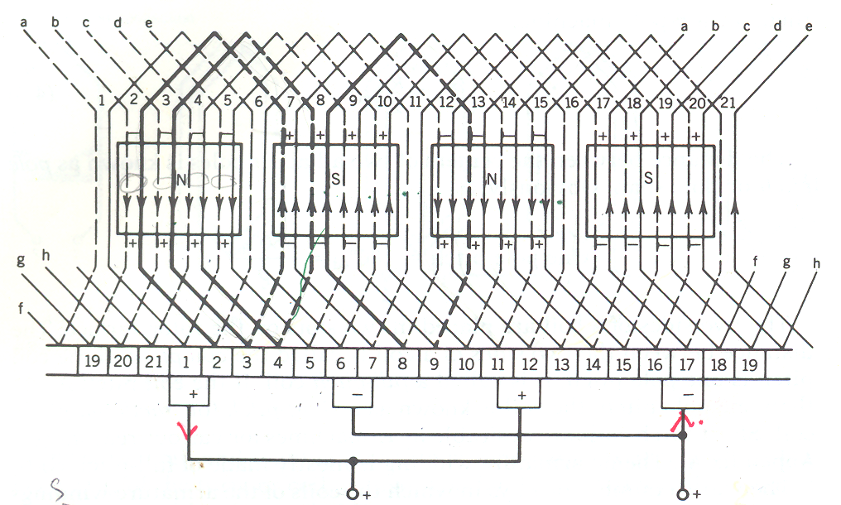
Elements of an armature windings

Slide 38
Elements of an armature windings
Wave winding
p/2 coils in series between adjacent commutator bars
½ of all coils between brushes
Regardless of no. of poles, there are always 2 parallel path
The distance between end coils (commutator pitch) is 2(C±1)/p where C is the no. of commutator bars

Slide 39
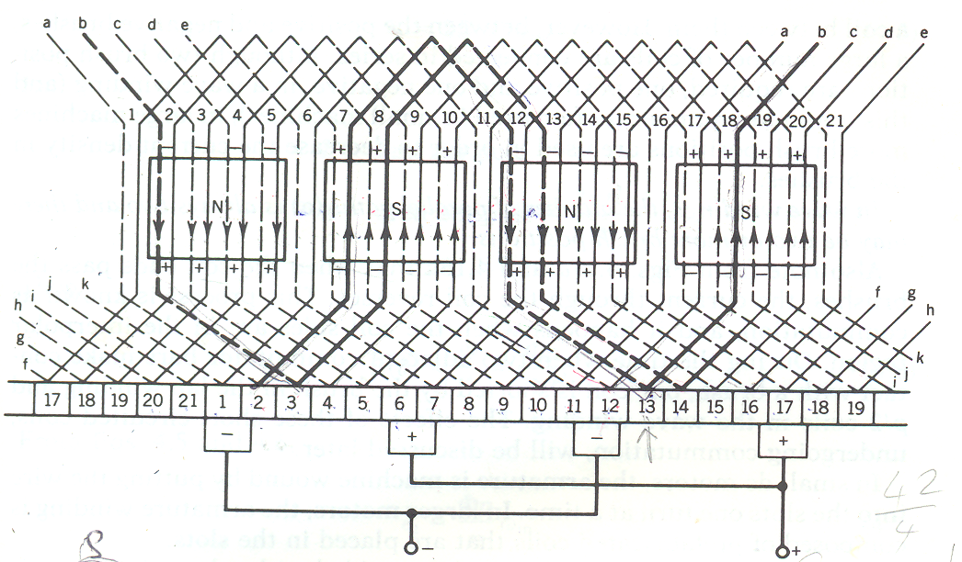
Elements of an armature windings

